Slide 1
The (Legal) Reliability of the Cadastre from the Perspective of
the Czech Republic
Mgr. Martina Hercegová
Ing. Karel Štencel
PCC - Conference Vienna
20. – 21. 11. 2018

Slide 2
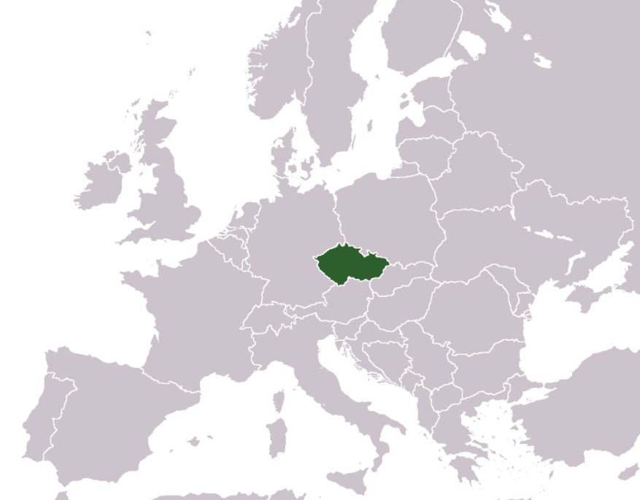
Basic information about the CR
Area: 78,866 km²
Population: 10 mil.
Administrative division: 14 regions
22 mil parcels
13,094 cadastral units

Slide 3
Land Administration System
Till 1993
Separated model
After the re-establishment of democracy in 1989
Merge model (from 1993)
Registration of
rights
Cadaster

Slide 4
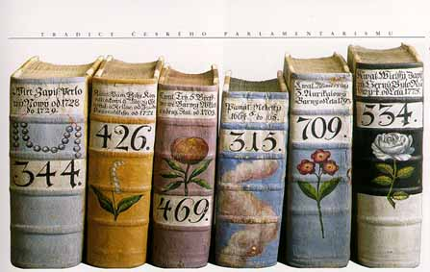
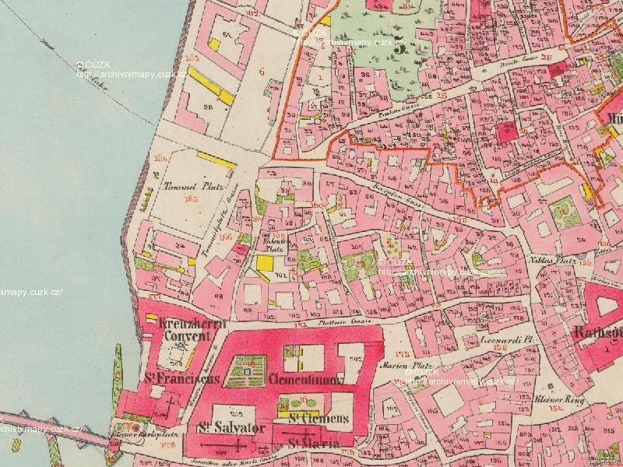
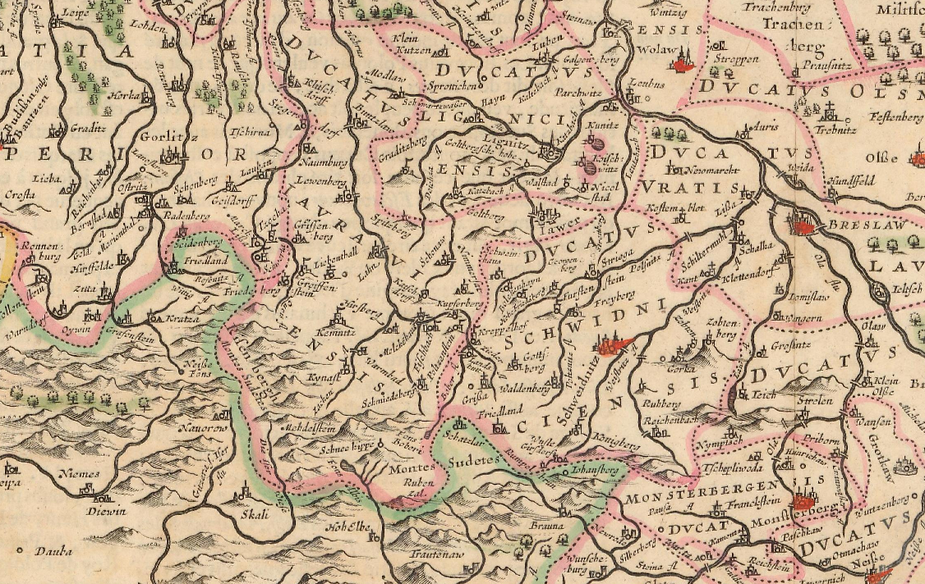
Land Records
Fiscal Cadastre
Topographic Mapping

Slide 5
Principle of Material Publicity
New Civil Code – Act. Nr. 89/2012 Coll. (NCC)
Material Publicity – what is written is given

Slide 6
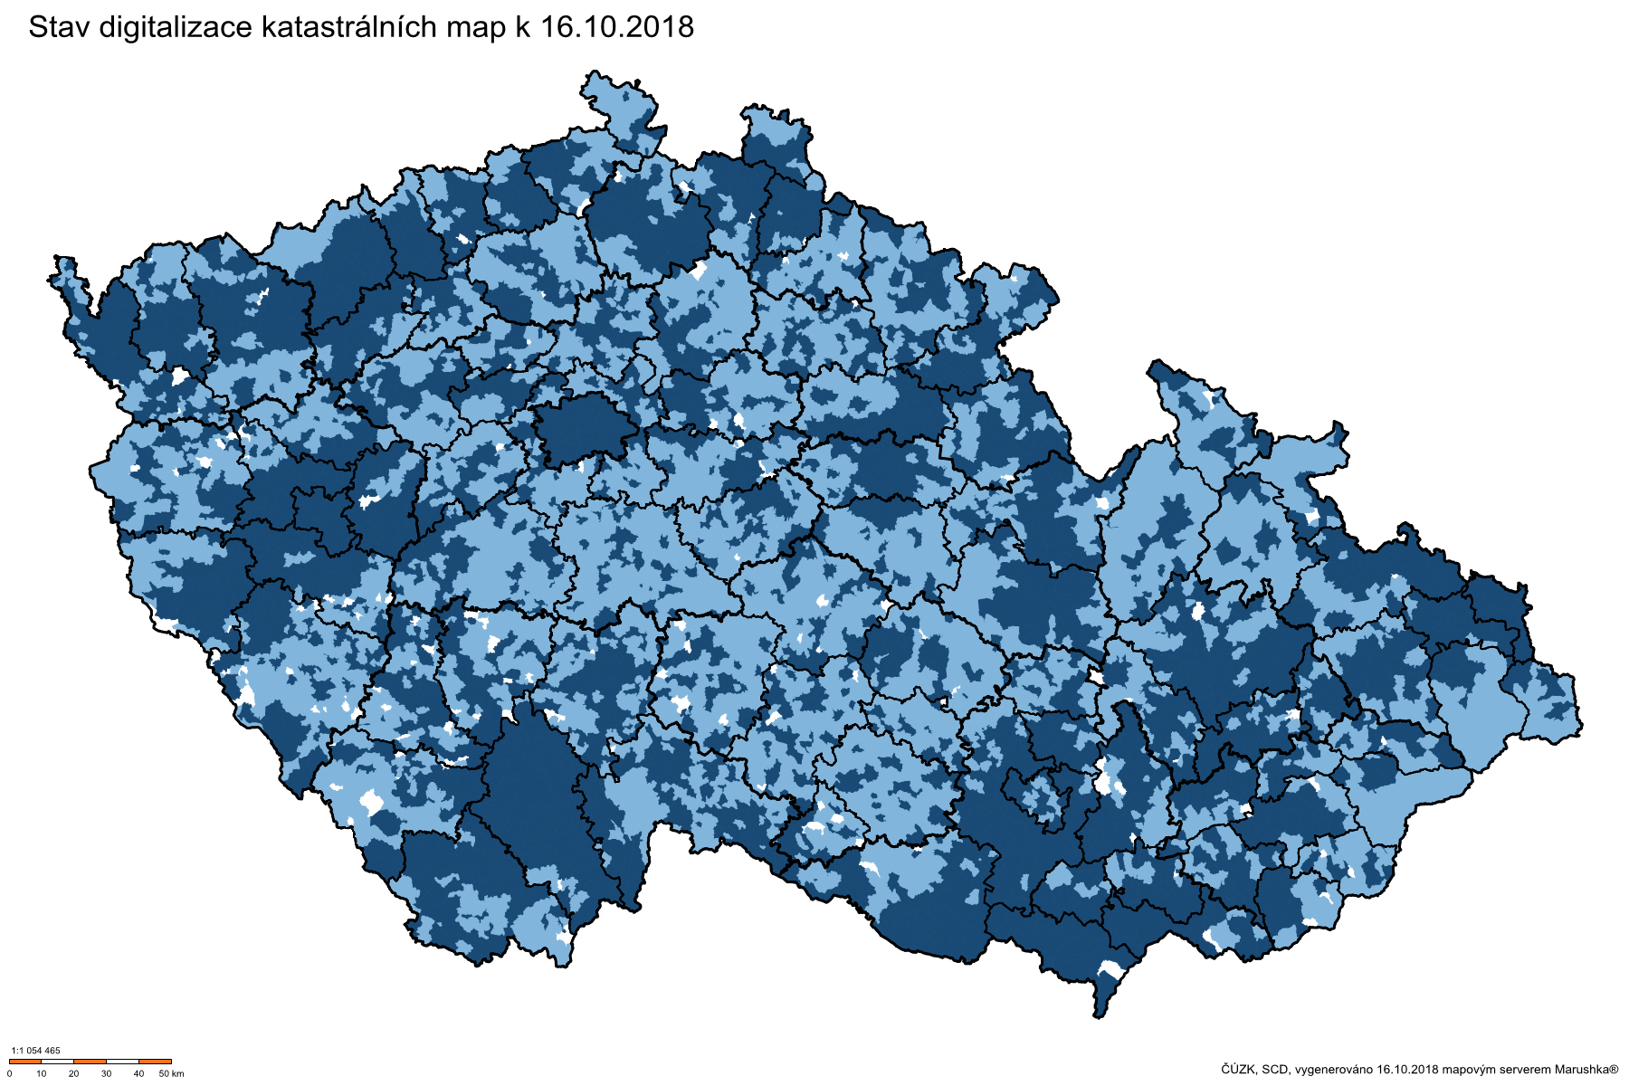
Digital Cadastral Maps in the Czech Republic
Stránka 6

Slide 7
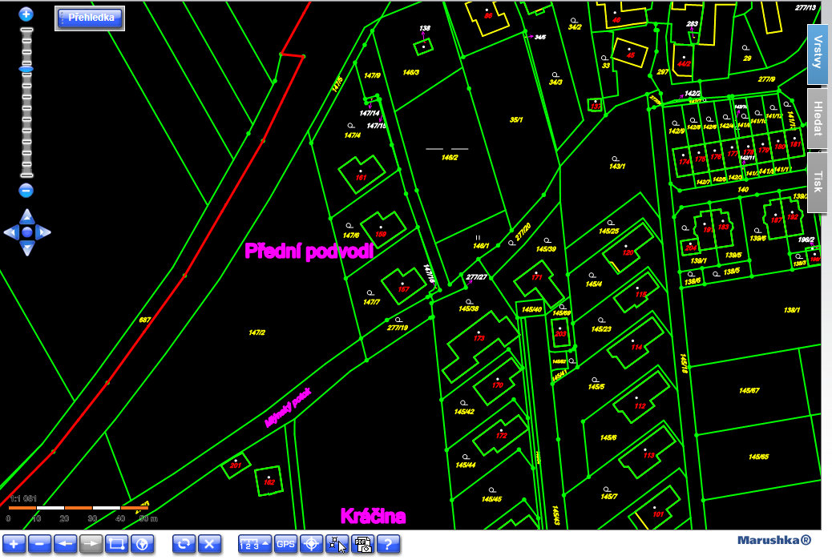
Digital Cadastral Map
Digital Cadastral Maps in the Czech Republic
Page 7

Slide 8
Two Basic Types of Maps
Maps Based on Original Measurement
New maps produced within last 70 years – 1/3 area CR
Current coordinate system, homogenous, accuracy 14 cm
Results of original measurement – coordinates calculation, later coordinates saved in register
No technical problems, only a lot of work, high quality result

Slide 9
Two Basic Types of Maps
2. Maps Based on Stable Cadastre
Originate from 1st half of 19th century
Different coordinate system, fathom scale, graphical triangulation – main reason of partial deformations, accuracy ? m
Different methods of updating within 150 years – source of many technical problems
Digitalization mainly by vectorization of raster images of cadastral maps

Slide 10
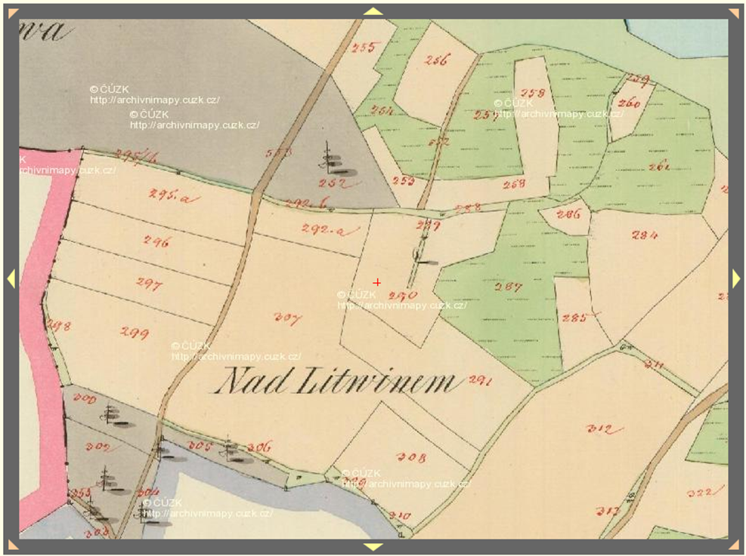
Map of Stable Cadastre
Prague, 12.04.2018
Page 10

Slide 11
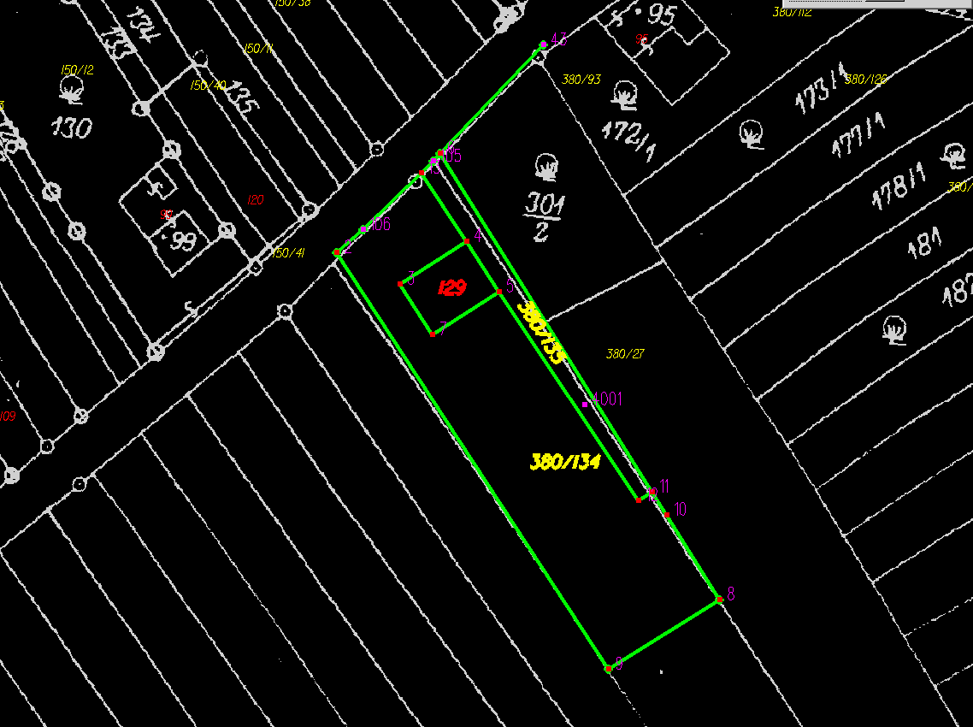
Digital Cadastral Maps in the Czech Republic
Using the results of measurement of changes to improve the precesion of map during digitization and subsequent updating

Slide 12
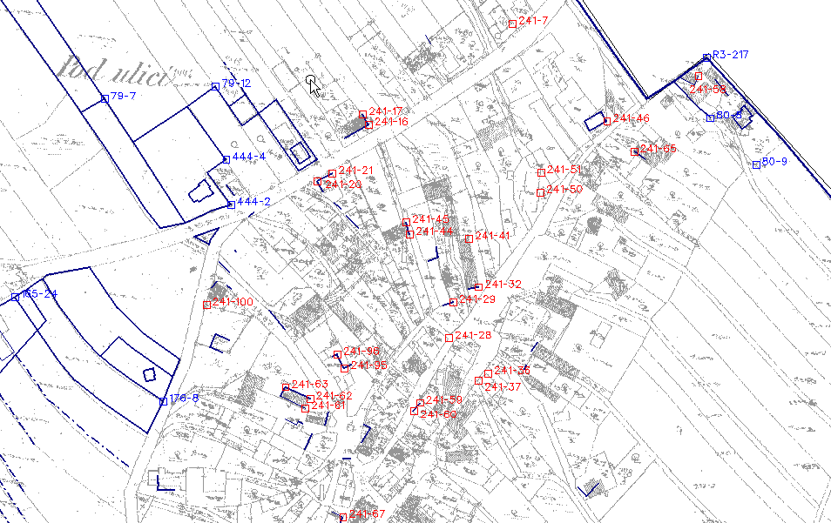
4. Technologie přepracování sáhových map
Transformace rastrových obrazů map do S-JTSK
Přehled identických bodů
Porovnání výsledků transformace s ortofotomapou
Detekce výsledků zeměměřických činností s chybným polohovým určením
Stránka 12

Slide 13
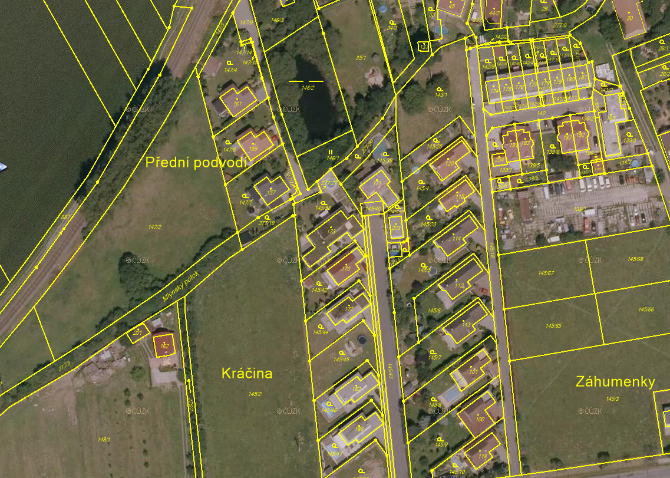
Digital Cadastral Map + ortophoto
Stránka 13

Slide 14
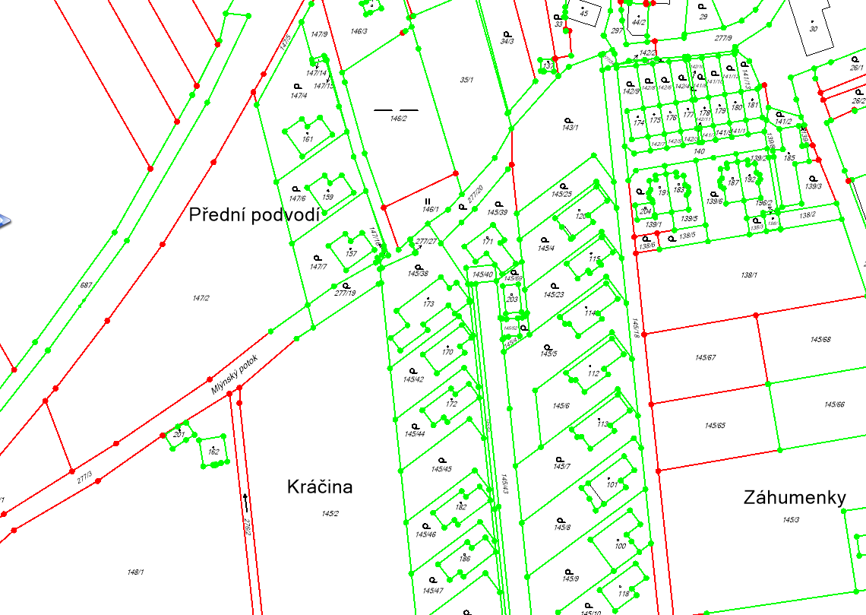
Digital Cadastral Map
Stránka 14

Slide 15
Refinement of Maps during their updates
Owners have the opportunity to review the quality of geodetic cadastral data and then refine these data
For refinement (improvement of the accuracy) of the boundaries, it is necessary to submit:
Survey Plan
Document signed by all the owners that they agree with the refinement of boundaries

Slide 16
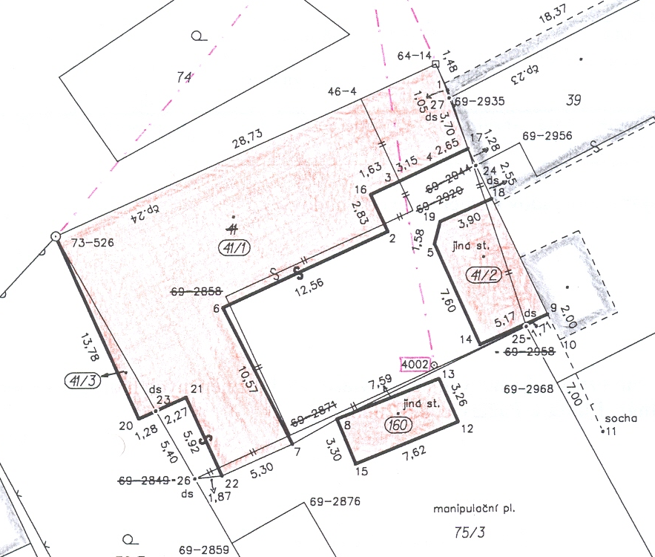

Slide 17
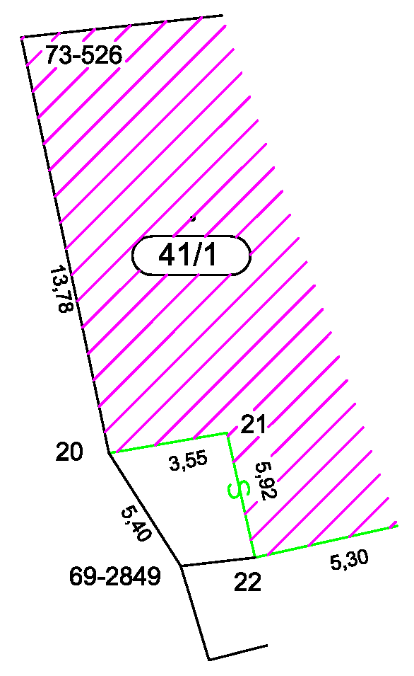
Refinement of Maps during their updates
Document signed by all the owners that they agree with the refinement of boundaries (agreement) = the ownership boundary is marked in the cadastral map
=>

Slide 18
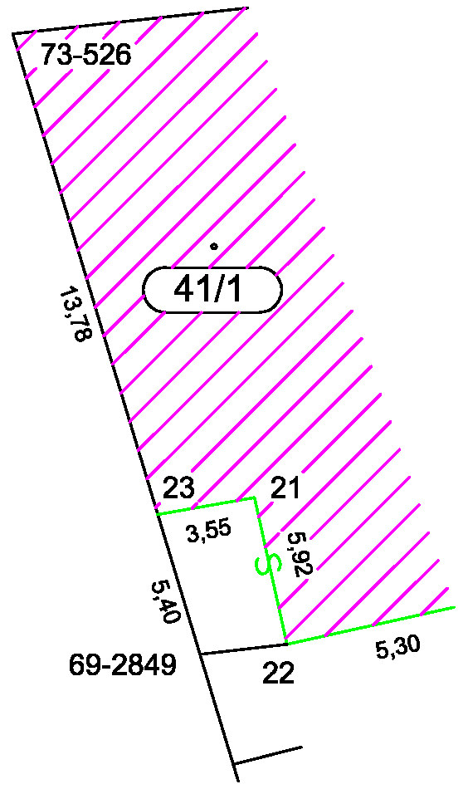
Refinement of Maps during their updates
Without the owner's agreement, the original boundary remains unchanged in the map
=>

Slide 19
Activities of the Cadastral Offices till 2030
Long term Conceptual Document – 2017
The most important issues:
Insufficient geometric quality of cadastral maps
Discrepancies between registered data and actual status in terrain caused by non-compliance with reporting obligations of the owners
Out-of-date technical data already registered (in particular data on land types, land use, type and mode of property protection)

Slide 20
Increasing the Geometric Quality of
Cadastral Maps
Completion of digitization does not solve the problem of insufficient cadastral map accuracy in approximately 60% of Cadastral Units
We will devote a part of the capacities to the works that will lead to the improvement of Cadastral Maps
New Mapping
The problem of geometric quality of Cadastral Maps is solvable within next 20-30 years

Slide 21
Process of New Mapping - Phases
Project
Preparatory Work
Investigation of Boundaries
Detailed Survey
Creating of new Cadastral Documentation
Presentation of Results to Owners (Public Consultation)
Solving Objections
Declaration of Effect of Renewed Cadastral Documentation

Slide 22
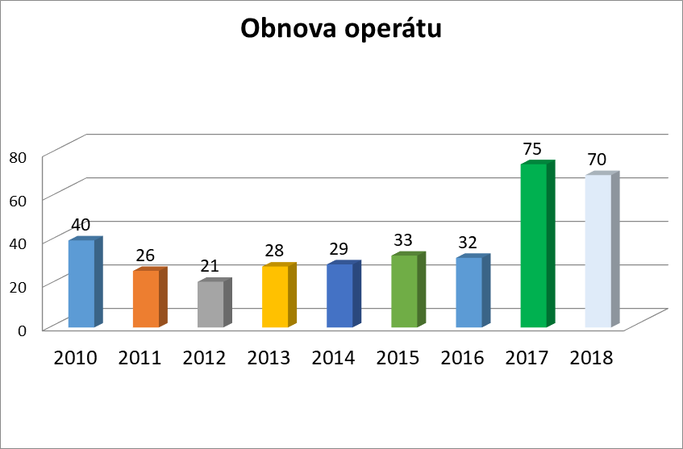
New Mapping
Number of renewed cadastral units

Slide 23
Investigation of Boundaries

Slide 24
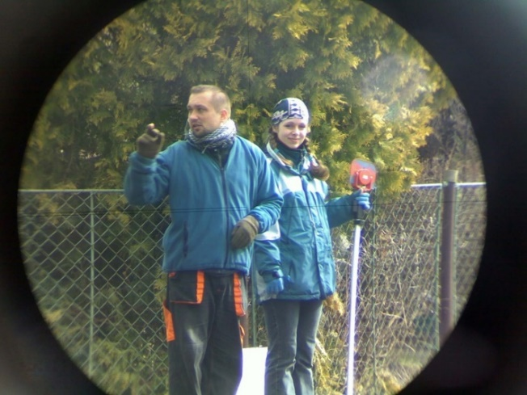
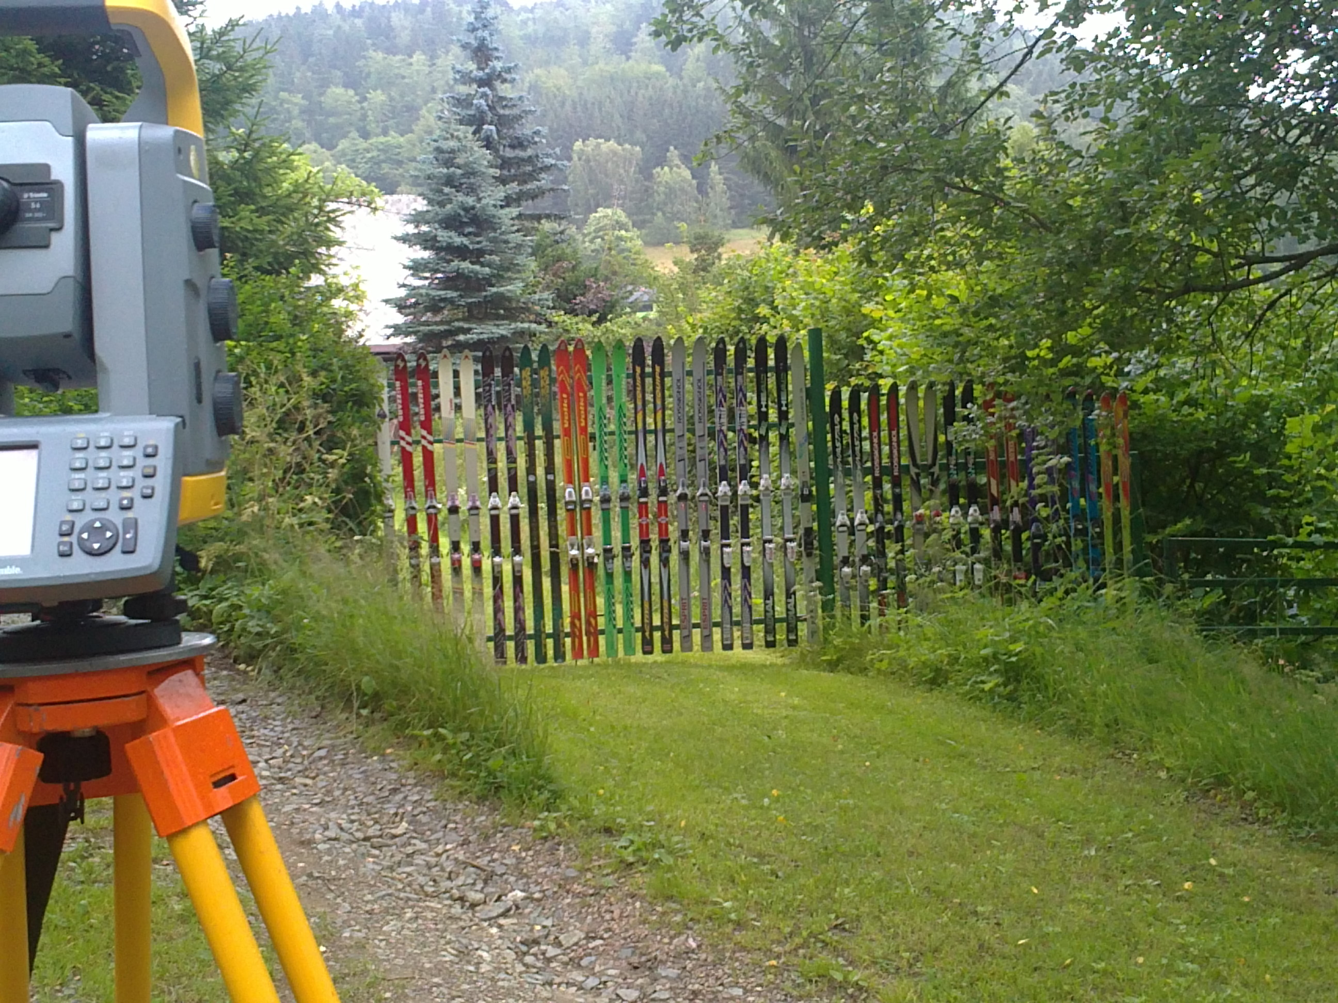
Detailed Survey - Used Technologies
New mapping – mostly combination of GNSS and terrestrial methods
Exploring the use of new technologies (laser scanning, super-precise ortophoto)

Slide 25
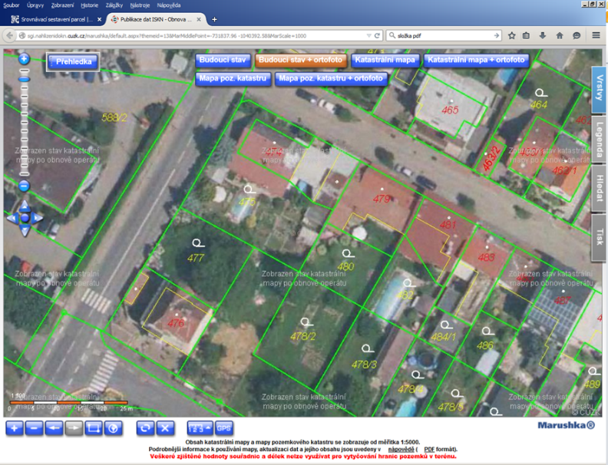
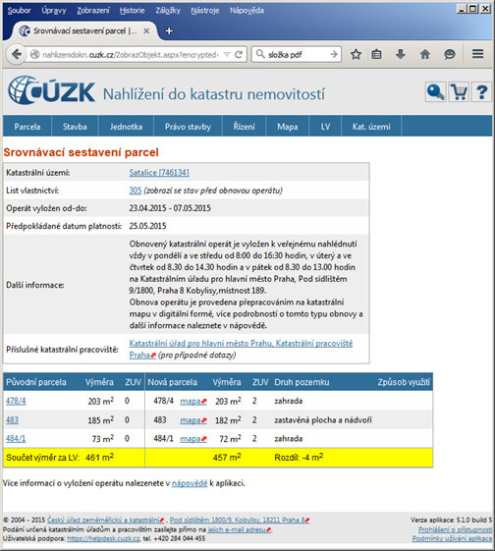
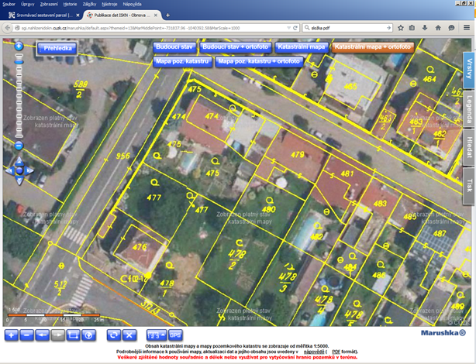
Presentation of Results to Owners
The new cadastral documentation is presented on web

Slide 26
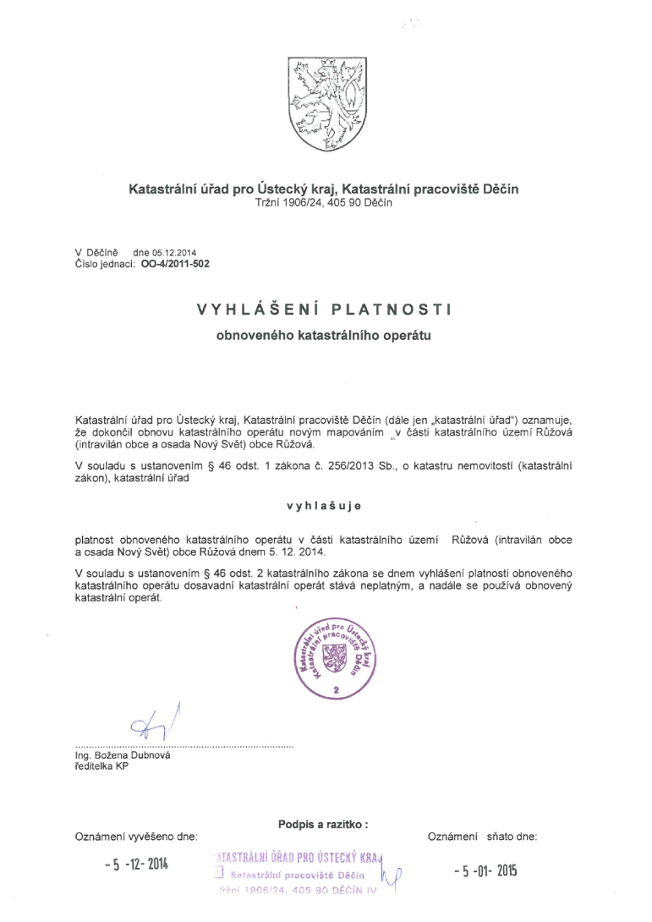
Declaration of Effect of Renewed Cadastral Documentation
The new mapping is completed by Declaration of Effect of Renewed Cadastral Documentation

Slide 27
Results
We improve quality of cadastral data for better use in multi-purpose geospatial information systems
We want to use digitalized maps for many years and refine them on the basis of Survey Plans
Some Cadastral Units will be necessary to map newly (150 cadastral units yearly)

Slide 28
Thank you for your attention.
www.cuzk.cz

